Slide 1

Airplane Crash Analysis
By Kausar Ali
Mentorness Internship | 2024 | Batch Name: MIP-DA-06

Slide 2
Problem Statement:
The objective of this project focuses on conducting a comprehensive analysis of airplane crashes and fatalities spanning from 1980 to 2023. The dataset contains crucial information such as crash dates, locations,operators, flight details, aircraft types, and fatality statistics. The goal is to leverage Power BI for interactive visualizations and in-depth insights to understand patterns, contributing factors, and trends in aviation incidents. The analysis aims to provide stakeholders with valuable information for enhancing aviation safety and mitigating risks.

Slide 3
Dataset Description:
1. Date: Date of the airplane crash.
2. Time: Time of the airplane crash.
3. Location: Location where the airplane crash occurred.
4. Operator: Operator or airline involved in the incident.
5. Flight #: Flight number associated with the incident.
6. Route: Planned route of the flight.
7. AC Type: Aircraft type involved in the crash.
8. Registration: Registration details of the aircraft.
9. cn/ln: Construction or serial number of the aircraft.
10. Aboard: Total number of individuals aboard the aircraft.
11. Aboard Passengers: Number of passengers aboard the aircraft.
12. Aboard Crew: Number of crew members aboard the aircraft.
13. Fatalities: Total fatalities in the incident.
14. Fatalities Passengers: Number of passenger fatalities.
15. Fatalities Crew: Number of crew member fatalities.
16. Ground: Casualties on the ground, if any.
17. Summary: Brief summary or description of the incident.

Slide 4

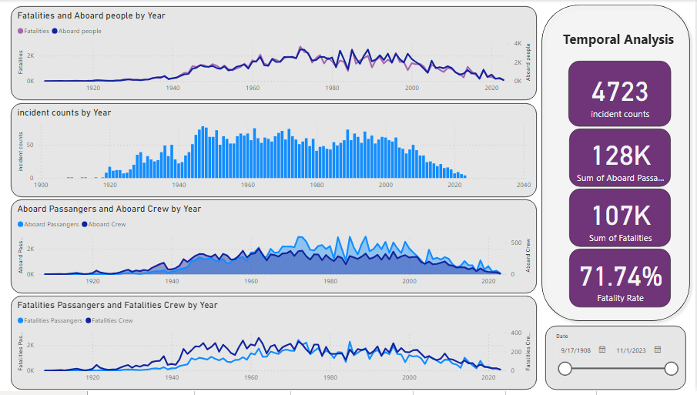

Slide 5
Temporal Analysis
Year 1972 was the with highest aboard people and with most fatalities.
The fatality rate was always high in 1972, at 82.16%. Fatalities Rate = Fatalities/aboard.
In 1947, most incidents happened with 78 incidents.
Aboard passenger and aboard crew were high in 1985, with passenger 2991 and crew 328.
Passenger fatalities and crew fatalities were always high in 1972, with passenger fatalities at 2421 and crew fatalties at 305.

Slide 6
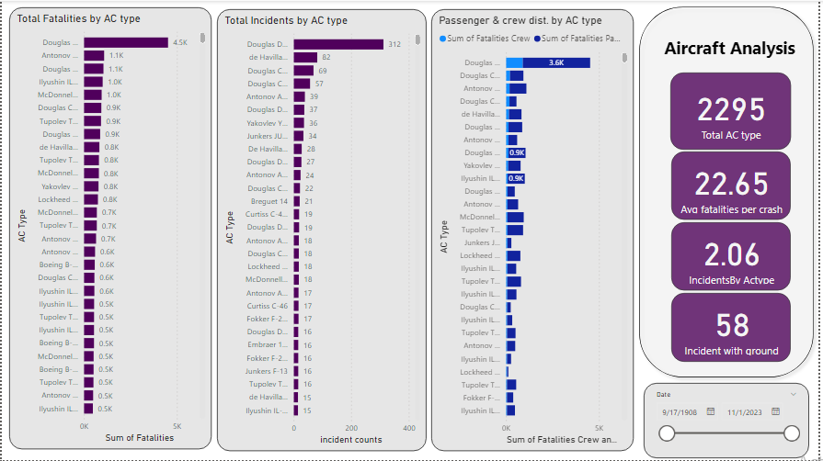

Slide 7
Aircraft Analysis
Incident counts were highest for the Douglas DX-3 at 320, followed by the De Havillland Canada DHC-6 Twin Otter 300 and the Douglas C-47A.
Total Fatality counts were highest by AC type: Douglas DC-3 at 4552, followed by Antonov An-26 at 1086, and Douglas DC-6B at 1051.
Fatality crew and fatality passenger are high for Douglas DC-3 crew at 903 and passengers at 3621.

Slide 8
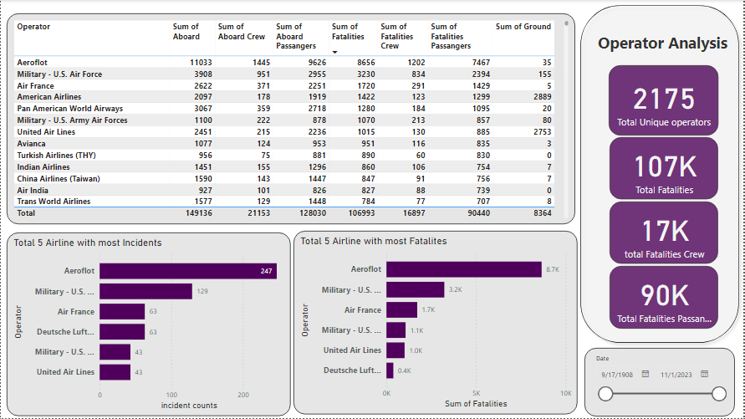

Slide 9
Operator Analysis
Incident counts were highest for Aeroflat at 247, followed by the Military-US Air Force at 129 and Air France at 63.
The fatality count was highest for Aeroflat at 8656, followed by the Military-US Air Force at 3230 and Air France at 1720.
Overall board members were 11033 at Aeroflat, consisting of aboard crew at 1445 and aboard passengers at 9626.
Overall fatalities were 8656 at Aeroflat, with fatalities for crew at 1202 and fatalities for passengers at 7467.

Slide 10
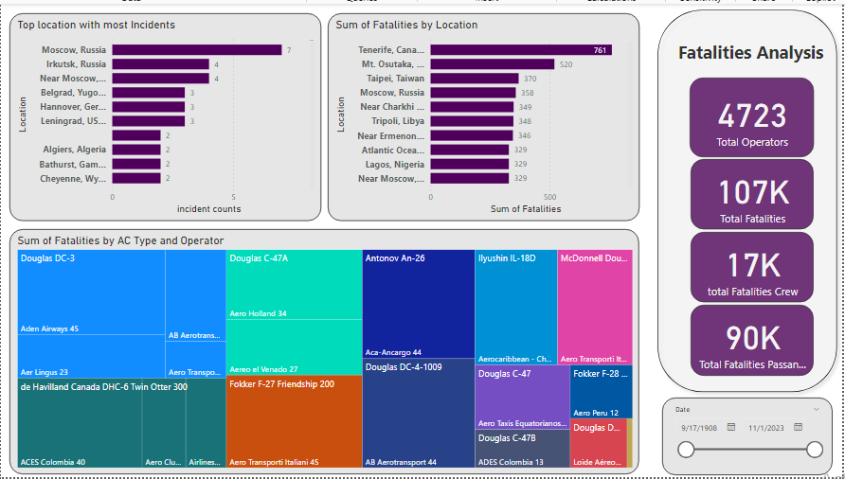

Slide 11
Fatalities trend
Mascow, Russia, has the highest incident rate at 7 incidents.
Tenerife, Canary Islands, had the highest fatalities at 762 fatalities.
Most of the fatalities happened by AC-type Douglas DC-3 and operators by Aden Airways.

Slide 12
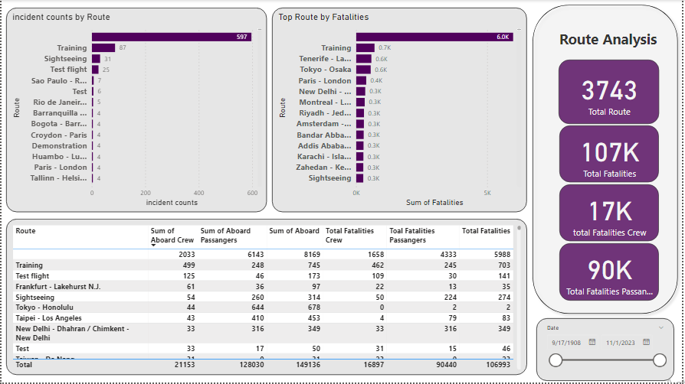

Slide 13
Route Analysis
Most Incidents happened on training route at 87, followed by Sightseeing at 31.
Most fatalities happened on training route at 703, followed by Tenerife - Las Palmas / Tenerife - Las Palmasat 583.

Slide 14
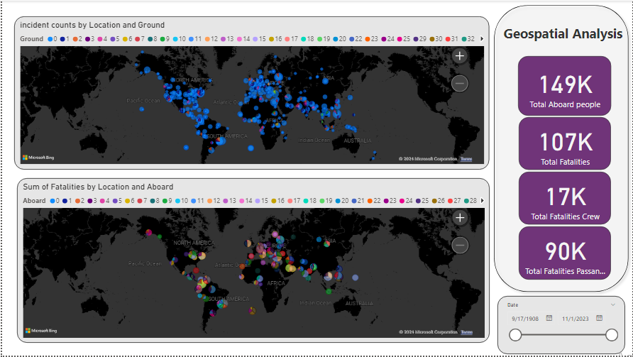

Slide 15
In the map incident happened in Europe, middle of south America and north America.
Bylooking in the map we can see most of fatalities happened in Europe and middle east area.

Slide 16
Thank you

